Slide 1

Linux Volume Management
Handy, but not RAID

Slide 2
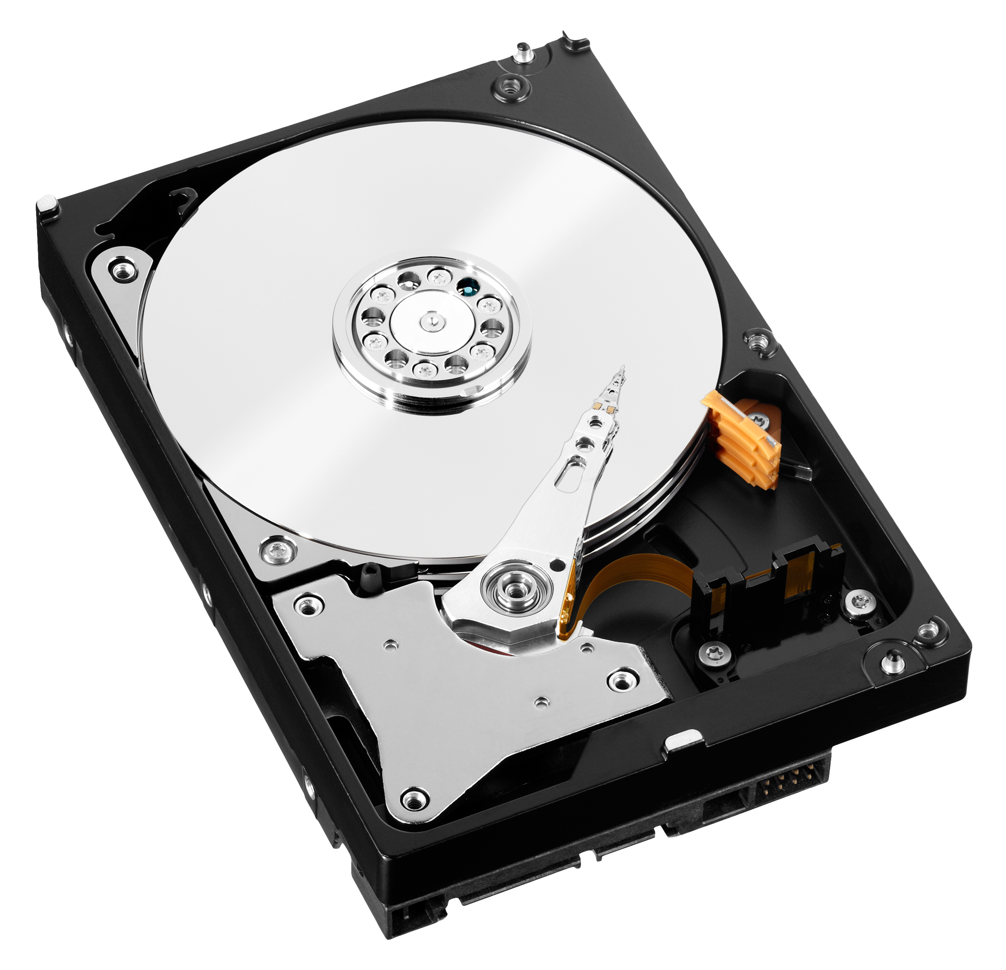
Step 1: Partition the disks
Physical Hard disks
Partitioned with partition type LVM (008E)
Can have single or multiple partitions

Slide 3
Step 2: Mark disks to participate in LVM
$ sudo pvcreate /dev/sdb1
Mark each partition as a physical volume (pvcreate)
Allows the volume to participate in a volume group
Use pvdisplay to display volume information
$ sudo pvcreate /dev/sdc1

Slide 4
Step 3: Create Volume Groups
Create a volume group (vgcreate)
You can create multiple volume groups using the physical volumes
Remember – a physical volume is a partition, not a hard drive
$ sudo vgcreate vol_group_1 /dev/sdb1
$ sudo vgdisplay
$ sudo vgextend vol_group_1 /dev/sdc1
$ sudo vgdisplay

Slide 5
Step 4: Create Logical Volumes
LV1
LV2
Create a logical volume (lvcreate)
You can create multiple logical volumes up to the capacity of the volume group
Remember – there is no redundancy
LV3
$ sudo lvcreate --name logvol_1 --size 5G vol_group_1
$ sudo lvdisplay
$ sudo lvcreate --name logvol_2 --size 5G vol_group_1
$ sudo lvcreate --name logvol_3 --size 5G vol_group_1
$ sudo lvcreate --name logvol_4 --size 5G vol_group_1

Slide 6
Using the newly created “devices”
the device names will be /dev/volgroup_name/logicalvol_name
in our example /dev/vol_group_1/logvol_1
These are treated the same as /dev/sd* devices
referred to as device mapper devices
/dev/dm-0 etc.
We can format them and mount them as regular devices

Slide 7
Formatting and mounting
$ sudo mkfs -t msdos /dev/vol_group_1/logvol_1
$ sudo mkfs -t ext4 /dev/vol_group_1/logvol_2
$ sudo mkfs -t ext3 /dev/vol_group_1/logvol_3
$ sudo mkdir –p /logvol/1
$ sudo mkdir –p /logvol/2
$ sudo mkdir –p /logvol/3
$ sudo mount /dev/vol_group_1/logvol_1 /logvol/1
$ sudo mount /dev/vol_group_1/logvol_2 /logvol/2
$ sudo mount /dev/vol_group_1/logvol_3 /logvol/3

Slide 8
Edit /etc/fstab
/dev/vol_group_1/logvol_1 /logvol/1 msdos defaults 0 0
/dev/vol_group_1/logvol_2 /logvol/2 ext4 defaults 0 0
/dev/vol_group_1/logvol_3 /logvol/3 ext3 defaults 0 0

Slide 9
Undoing our work (you can’t just dd it!)
umount our mounted volumes
1
remove entries from /etc/fstab
2
delete mount points
3
lvremove all logical volumes
4
vgremove all volume groups
5
pvremove all physical volumes
6

Slide 10
Undoing our work
$ sudo umount –a # unmount all disks $ sudo nano /etc/fstab # edit /etc/fstab and remove # entries
$ sudo rm –rf /logvol # remove the mount point
$ sudo lvremove /dev/vol_group_1/logvol_1 # remove logical volume 1 $ sudo lvremove /dev/vol_group_1/logvol_2 # remove logical volume 2 $ sudo lvremove /dev/vol_group_1/logvol_1 # remove logical volume 3
$ sudo vgremove vol_group_1 # remove the volume group
$ sudo pvremove /dev/sdb1 /dev/sdc1 # remove marked physicals
$ sudo mount –a # remount everything

